Slide 1
CyberShield: Securing Websites with Embedded Electronic Ecosystem
Aryan Singh (1MS20ET011)
Chaitra (1MS20ET014)
Chandan Kumar (1MS20ET015)
Pranayak Uniyal (1MS20ET035)
Dr. S. G. Shivaprasad Yadav
(Associate Professor, Dept of ETE)
Total proposed Budget: Rs 40,210/-

Slide 2

Introduction and Motivation
In today's hyperconnected digital landscape, websites have become the lifeblood of businesses, organizations, and individuals alike. They serve as gateways to information, services, and transactions, making them invaluable assets, this increased reliance on the digital realm has also exposed websites to cybersecurity threats and vulnerabilities.
However, this increasing dependence on web applications and online services has come at a price. According to a report by Cybersecurity Ventures, cybercrime is projected to cost the world $6 trillion annually by 2021, with an expected rise in the coming years. In 2020, the FBI's Internet Crime Complaint Center received over 791,790 complaints of cybercrimes, resulting in reported losses exceeding $4.2 billion and 73 publicly disclosed security incidents in August 2023, and they accounted for 79,729,271 compromised records.
Data breaches have exposed sensitive information of millions of individuals, including personal, financial, and healthcare data, leading to identity theft and fraud on an unprecedented scale.

Slide 3

Problem Statement and Novelty
Problem Statement:
With increasing dependence on web applications and online services, cyber threats lead to serious exploitation.
Novelty: Our project brings real-time vulnerability detection and rectify them through embedded system integration, enhancing security in a dynamic digital environment.

Slide 4
Objectives
Design and Develop a Raspberry Pi-Based System: Create a hardware and software solution using Raspberry Pi that is capable of automated web vulnerability scanning.
Integrate Vulnerability Databases: Integrate and regularly update a database of known vulnerabilities (e.g., CVE) to compare and identify security weaknesses in target websites.
Implement Scanning Algorithms: Develop scanning algorithms and techniques to comprehensively evaluate websites for common vulnerabilities, ensuring accuracy and efficiency.
Generate Comprehensive Reports: Design a reporting system that generates detailed vulnerability reports, including severity levels and recommended remediation steps, for easy understanding by users.
Ensure User-Friendly Interface: Create a user-friendly interface (web-based or command-line) that allows users to input website URLs, initiate scans, and view scan results, making the tool accessible to both security professionals and non-experts.

Slide 5
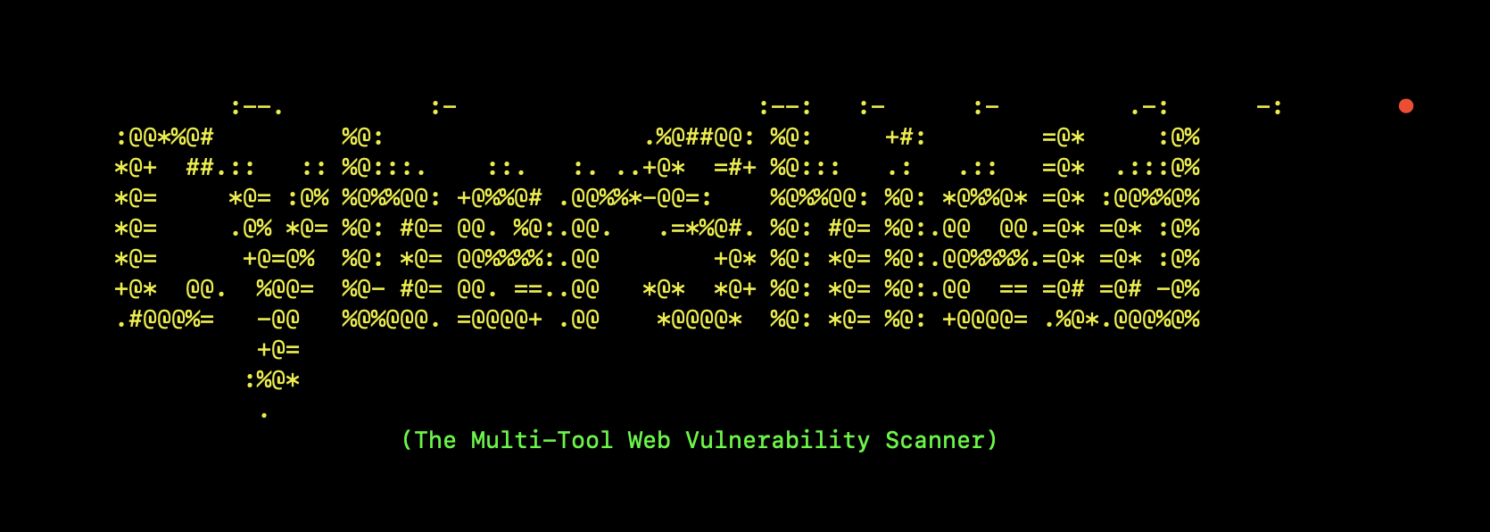
Prior work related to this project
We have started implementing the related python code for taking the URL of website as input and performing operation on it. We are currently trying to run checks for all well-known bugs and implementing the already available relevant tools of security in Linux operating systems.

Slide 6
Solution Methodology
Designing and Creating a Robust Security System -: Create a hardware and software solution using Raspberry Pi that is capable of automated web vulnerability scanning.
2. Customization as per user need to provide most relevant solution.
3. Attempt to fix possible vulnerabilities and reporting using available tools

Slide 7

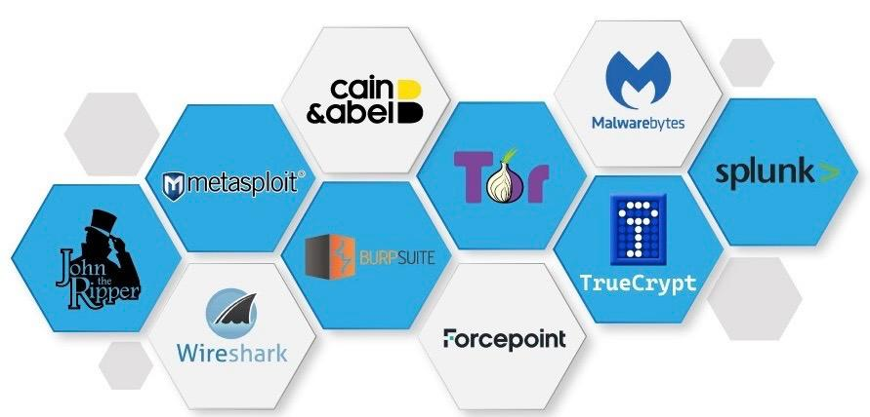
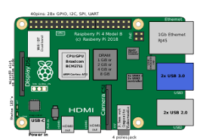
Solution Methodology
The Raspberry Pi 4 serves as the central processing unit for the device.
The "Terminal App" is the user interface where users interact with the device.
The “Vulnerability Assessment Engine“ performs the actual scanning and assessment of websites using several tools.
The "Vulnerability Assessment Engine" are responsible for rectifying the possible vulnerabilities identified by the corresponding tools.
The "Storage and Upload Module" handles saving and uploading the updated report

Slide 8
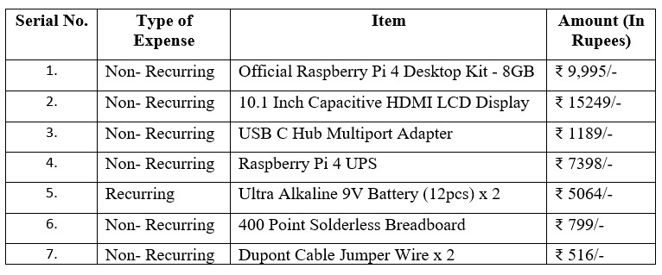
Proposed Budget
Total proposed Budget: Rs 40,210/-

Slide 9
References
Abdulqader, F. B., Thiyab, R. M., & Ali, A. M. (2017). The impact of SQL injection attacks on the security of databases. In Proceedings of the 6th International Conference on Computing and Informatics (pp. 323-331).
Kirti Randhe, "Security Engine for prevention of SQL Injection and CSS Attacks using Data Sanitization Technique", IJIRCCE, 2015.
J. Fonseca. Seixas, M. Vieira, and H. Madeira, "Analysis of Field Data on Web Security Vulnerabilities", IEEE Transaction on dependable and secure computing, vol. 11, no. 2, March/April 2014.
Jose Fonseca, Marco Vieira, and Henrique Madeira, "Evaluation of Web Security Mechanisms Using Vulnerability and Attack Injection", IEEE transaction on Dependable and secure compu-ting, Vol. 11, No. 5, 2014
Zoron Djuric, "Black Box Testing tool for Detecting SQL Injection Vulnerabilities", IEEE, 2013.

